Slide 1
Animation in the browser

Slide 2
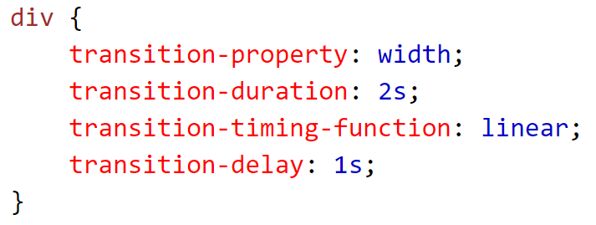
CSS:transitions

Slide 3
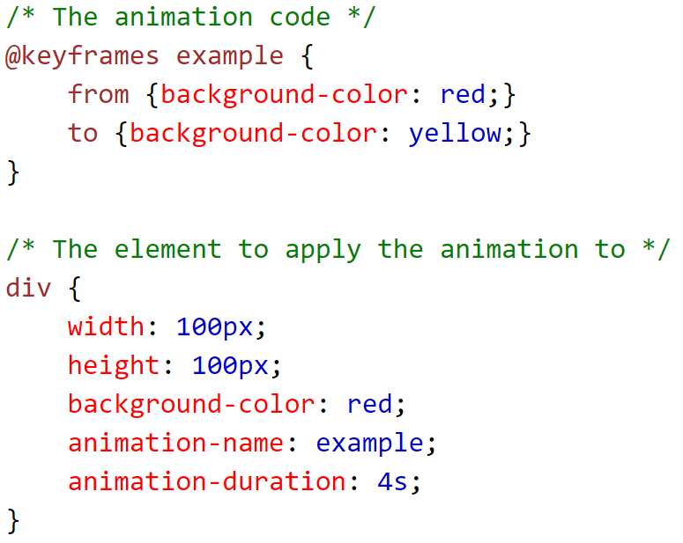
CSS:keyframes

Slide 4
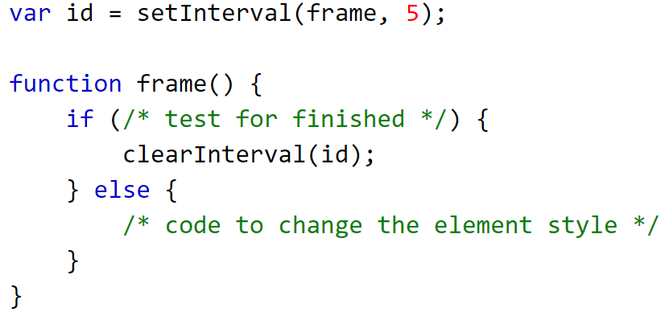
JavaScript?

Slide 5
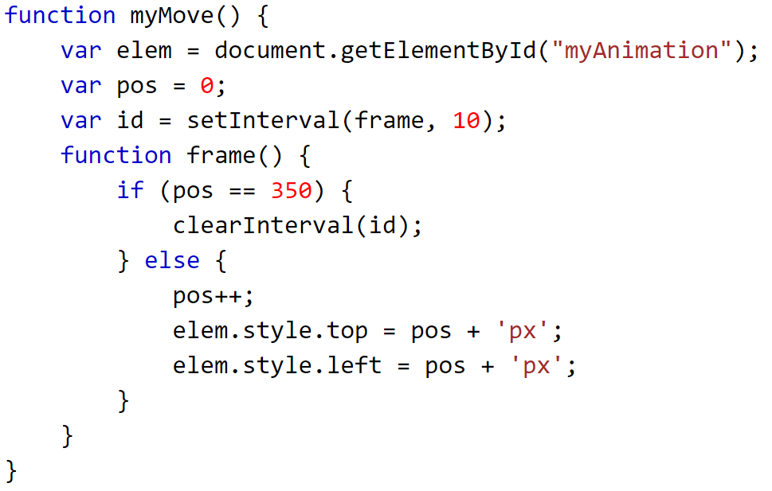
...

Slide 6
requestAnimationFrame
Frame rate management
Battery friendly

Slide 7


Slide 8


Slide 9

Links
Connect:
LinkedIn: https://goo.gl/CRRJ2Y
Mail: martin.c@sbtech.com
Github: https://github.com/mchaov

